Slide 1
Survey Platform
By: Rovin Singh
Mtech CSE

Slide 2
Problem Statement
The goal is to build a secure and flexible survey platform that addresses common issues with existing solutions. Current platforms often don’t allow targeted participant recruitment and store sensitive data insecurely. They also don’t give survey conductors control over data storage, often limiting them to using the platform’s own servers. Moreover, these platforms are usually focused on either market research or academic surveys, lacking a comprehensive solution for various survey needs. This new platform aims to solve these issues by prioritizing security, flexibility, and reliability.

Slide 3
Need
Lack of Indigenous Solution
Data Privacy Concerns
Bias in Survey Participation
Need for Versatility
Challenges:
Handling Microservices
Enabling Custom Data Storage
Balancing Security and Usability

Slide 4
Solution Overview
Security First
End-to-end encryption for sensitive data
Multiple deployment options including self-hosted
Compliance with various regulations
Comprehensive audit logging
Access Based Controls
Flexible Data Storage
Pluggable storage backends
Support for self-hosted or cloud storage
Custom retention policies
Automated backup systems
Targeted Recruitment
Advanced participant management system
Demographic profiling capabilities
Custom recruitment criteria
Automated matching system
Universal Platform
Support for both academic and market research
Customizable templates and question banks
Advanced logic building for complex surveys
Comprehensive analysis tools
Multiple export formats

Slide 5
Implementation
Design Document: https://docs.google.com/document/d/1Ws0B-GwNmCxHQ9AF7fx6CBMzIsiRg7JEbPwOeGqeTSk/edit?tab=t.0
Code Repository: https://github.com/rovin99/Survey-Platform

Slide 6
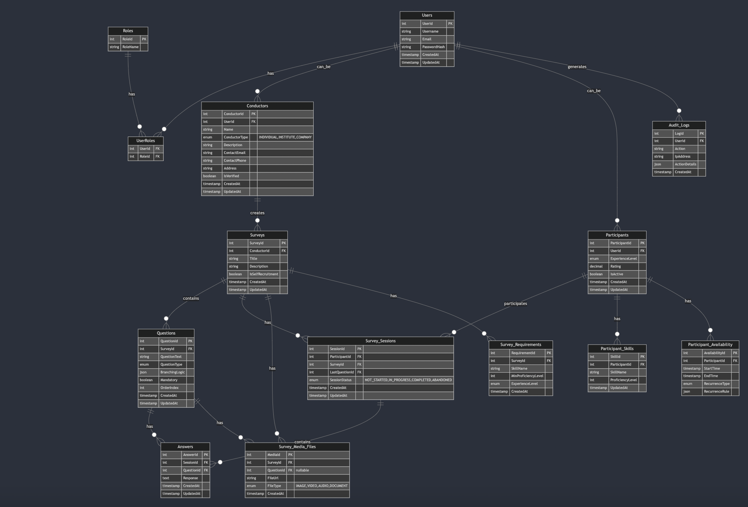
DB Schema

Slide 7
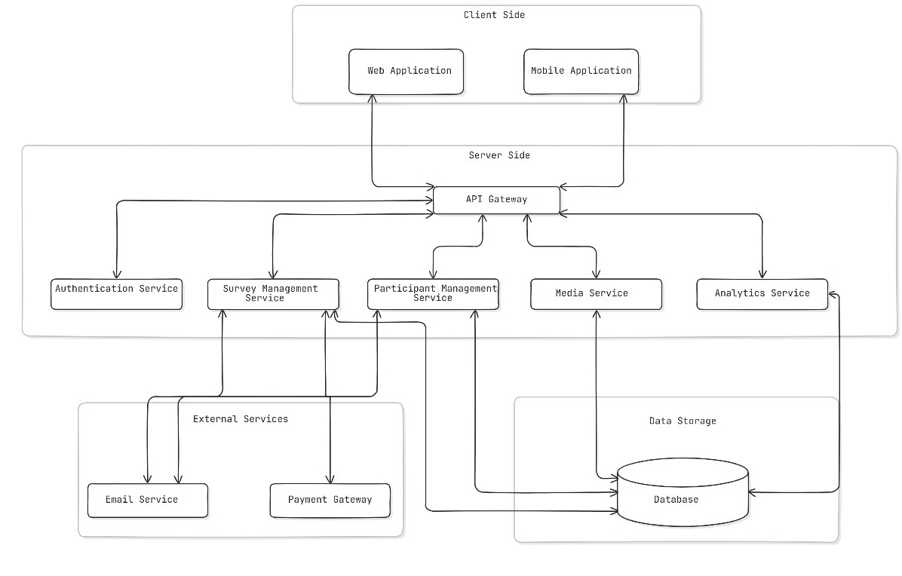
High Level Design

Slide 8
Future Scope
Integrating RAG for improving engagements
Implementing Messaging feature between Conductor and Participants.
Decentralized Data Storage and Blockchain

